Slide 1





How do bacteria adapt to salinity?
Large-scale phylogenomics of aquatic bacteria reveal molecular mechanisms for adaptation to salinity
Krzysztof T Jurdzinski, Maliheh Mehrshad, Luis Fernando Delgado, Ziling Deng, Stefan Bertilsson, Anders F Andersson

Slide 2


Slide 3
Few words about salinity…
Major factor determining community composition across habitats (Lozupone and Knight 2007) -> affects basic physiology and biochemistry.
Three aquatic biomes: freshwater, brackish, marine.
Rapid regional changes in the past -> rapid changes now.
(Hugerth et al 2015)

Slide 4
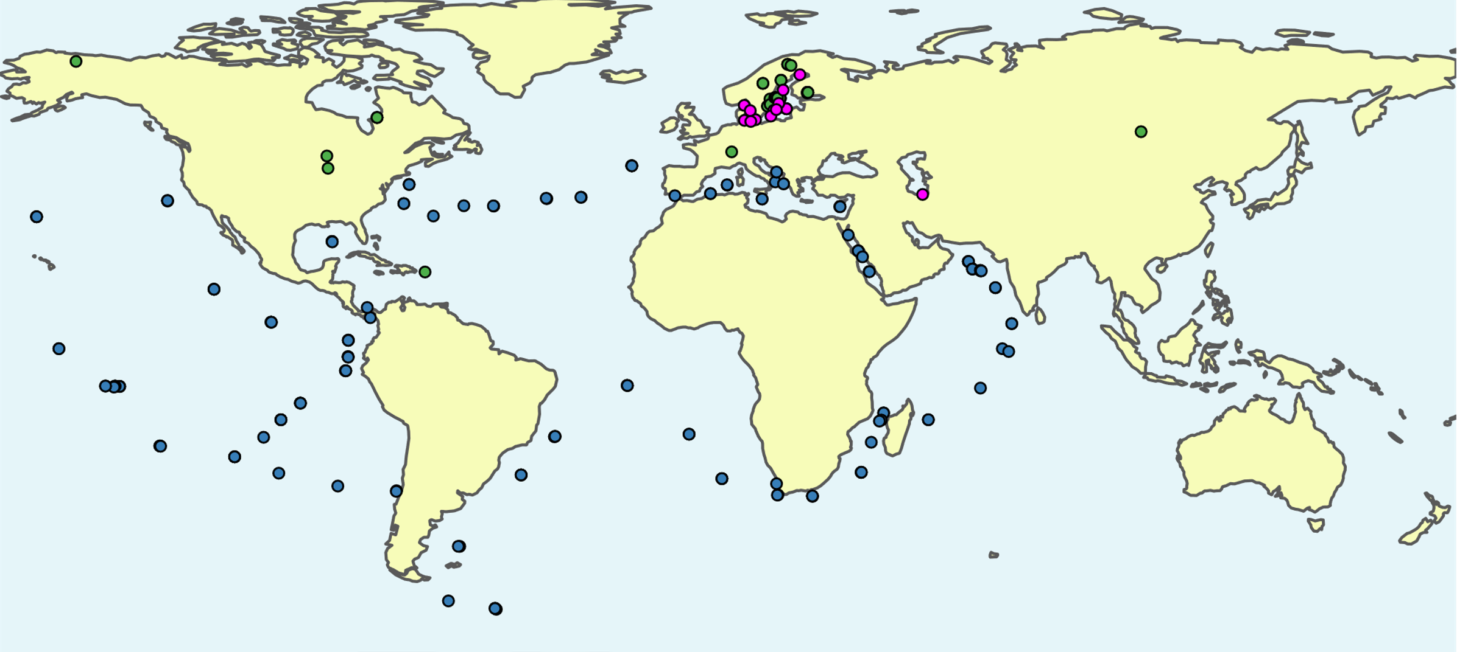
Comparative genomics based on publicly available metagenome-assembled genomes (MAGs)
Linz et al. (2018)
Buck et al. (2021)
Cabello-Yeves et.al. (2018)
Alneberg et al. (2020)
Mehrshad et al. (2016)
Tully et al. (2018)
Delmont et al. (2017)
Metagenomes: 416 freshwater, 126 brackish, 243 marine
11,248 MAGs; 3575 ~species: 2073 freshwater, 498 brackish, 1004 marine

Slide 5
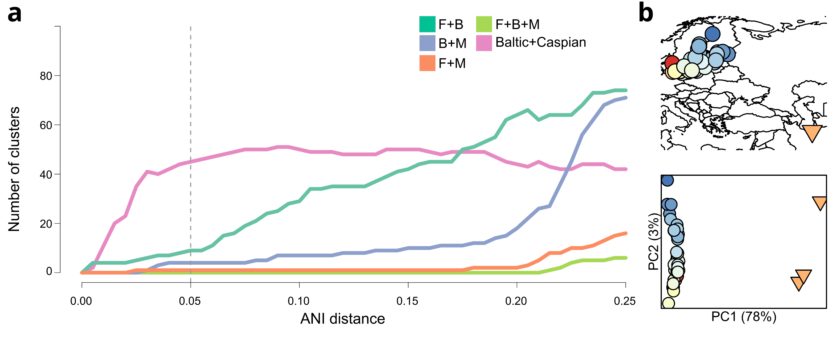
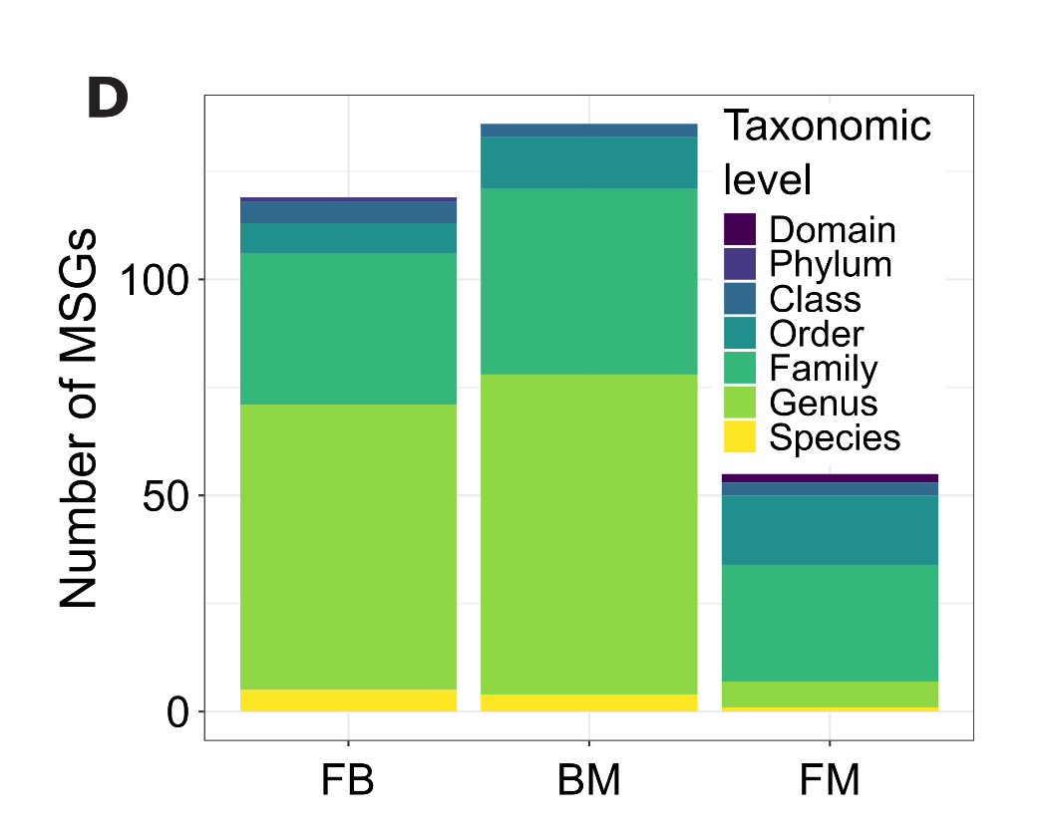
Species-level separation between biomes
One-biome 95% ANI clusters: 2063 freshwater, 485 brackish, and 999 marine
9 FB, 4 BM, and 1 FM
Brackish: 300 Baltic, 141 Caspian, 44 common
Species-level separation between biomes

Slide 6
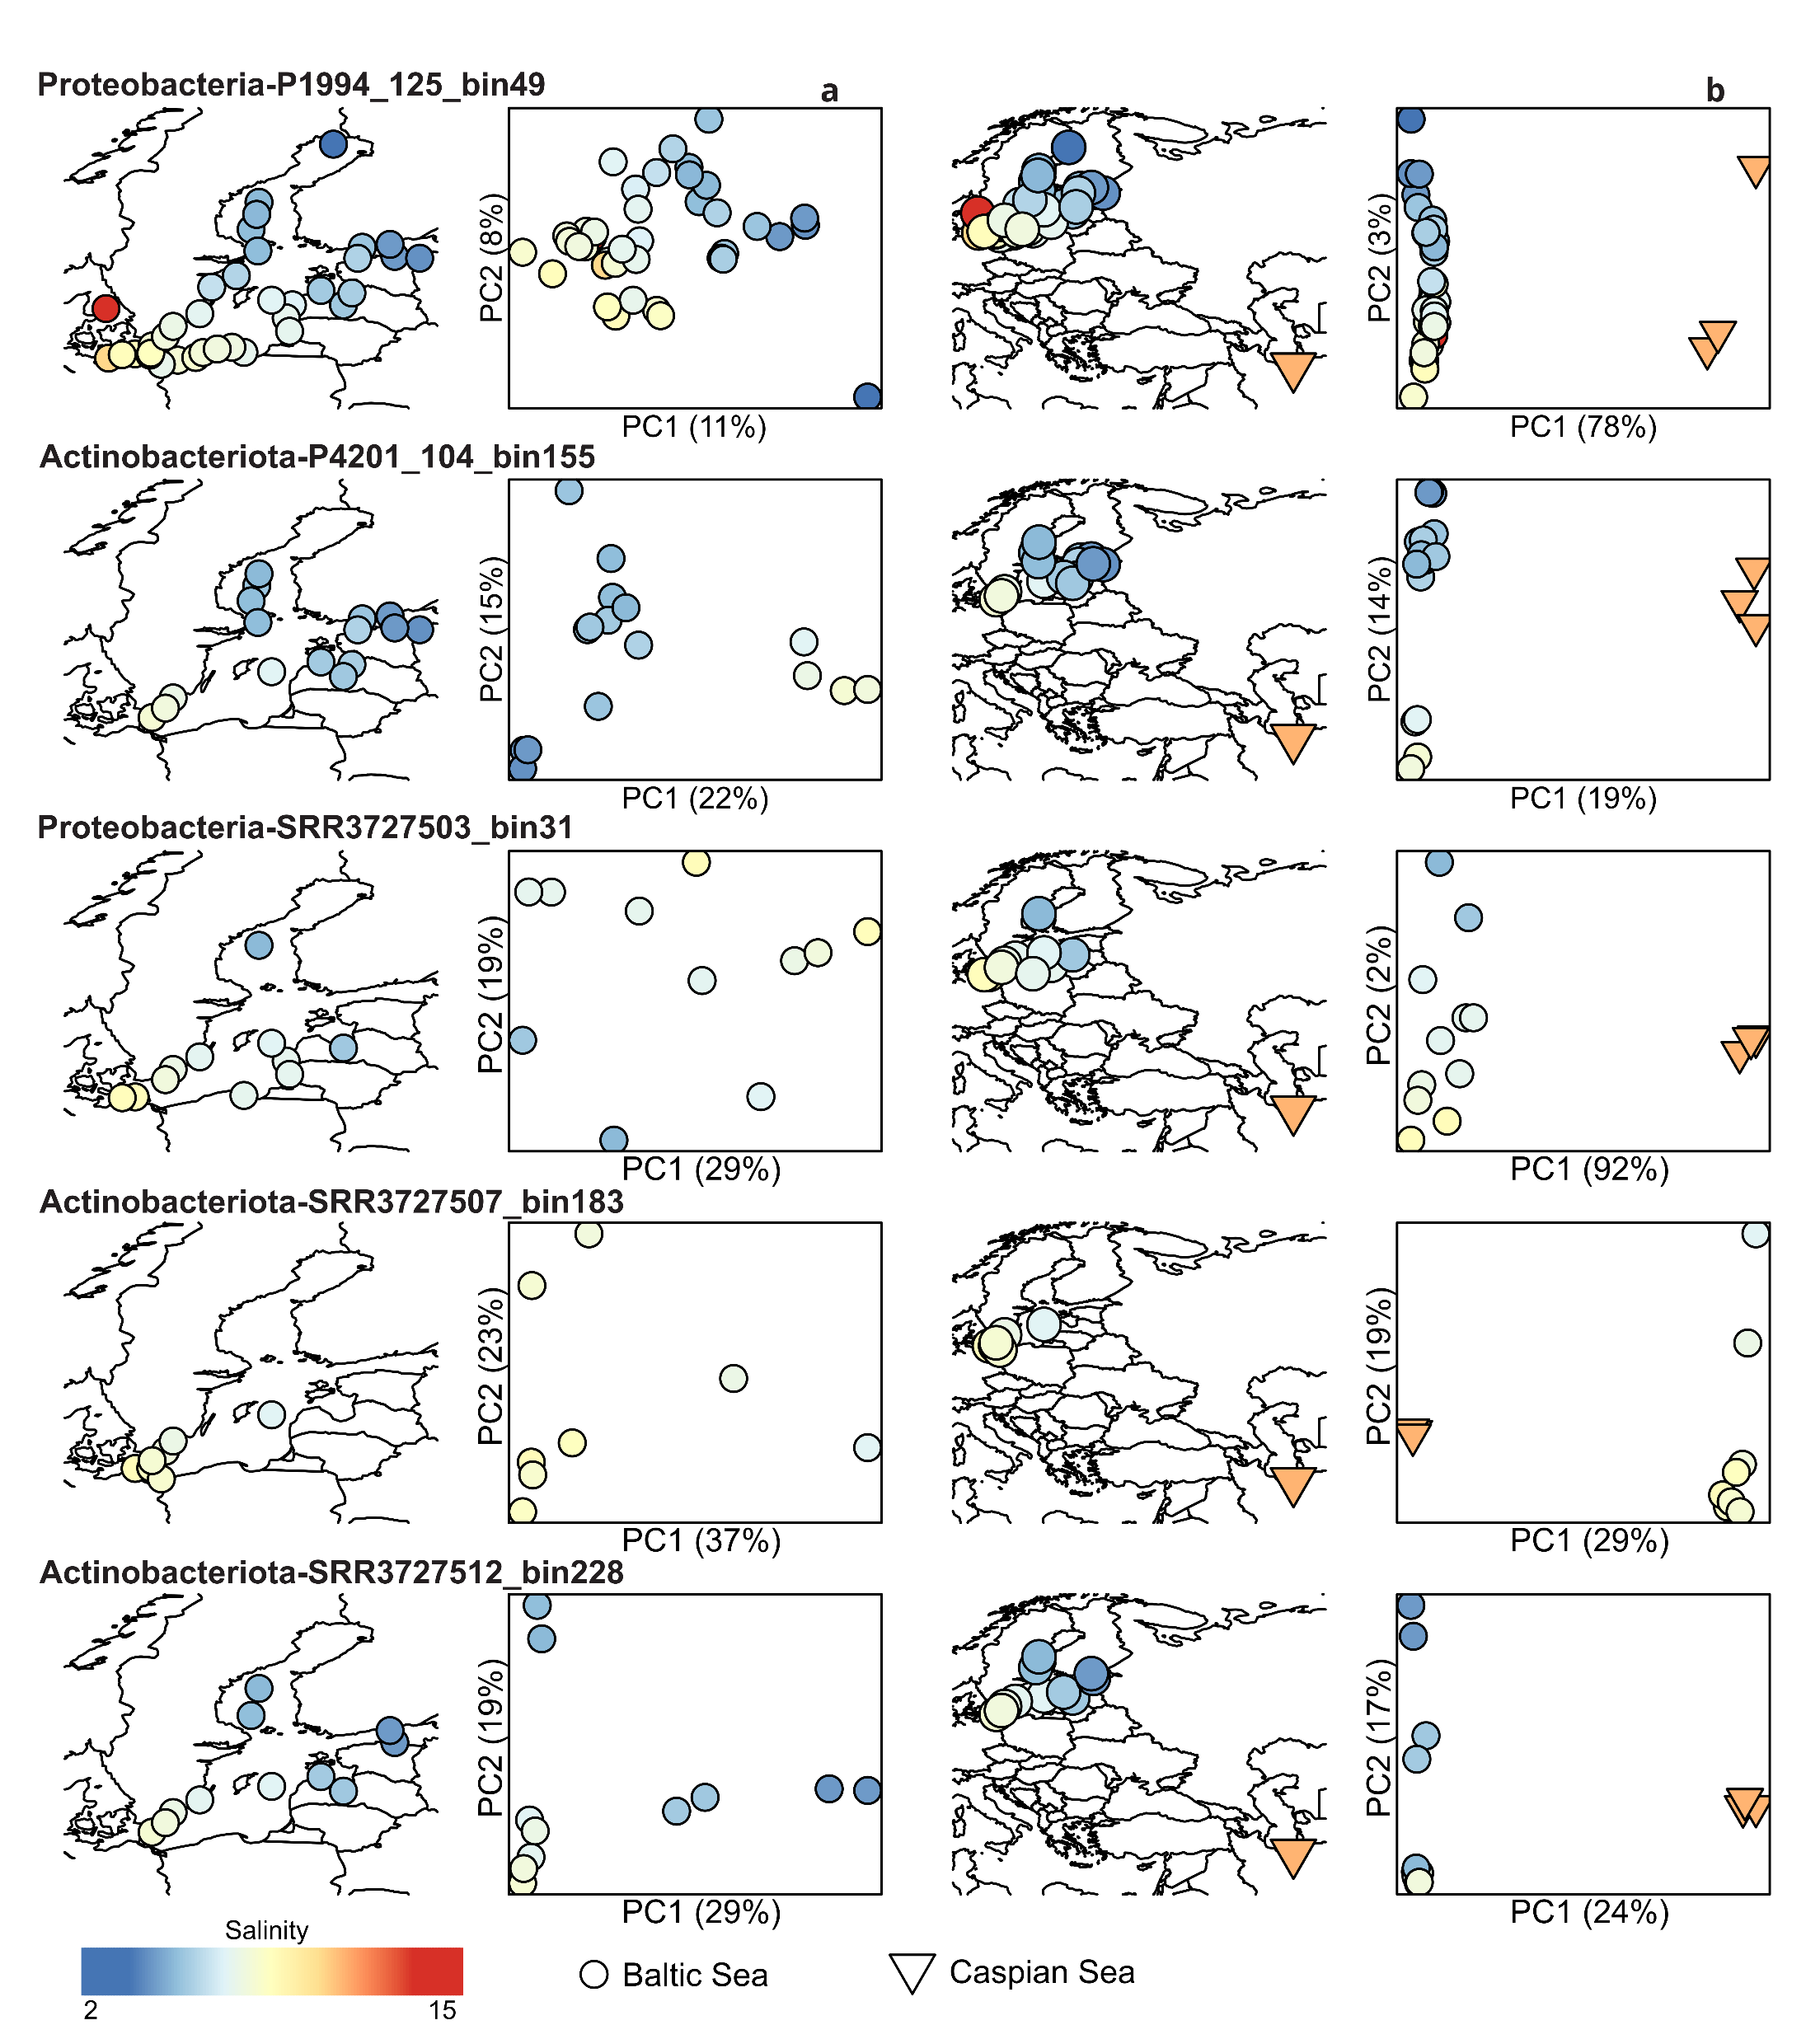
Population genomics: geographic microdiversity within brackish biome
Stronger effects of geographic isolation than salinity
Done using POGENOM (Sjöqvist et al. ISME 2021)

Slide 7
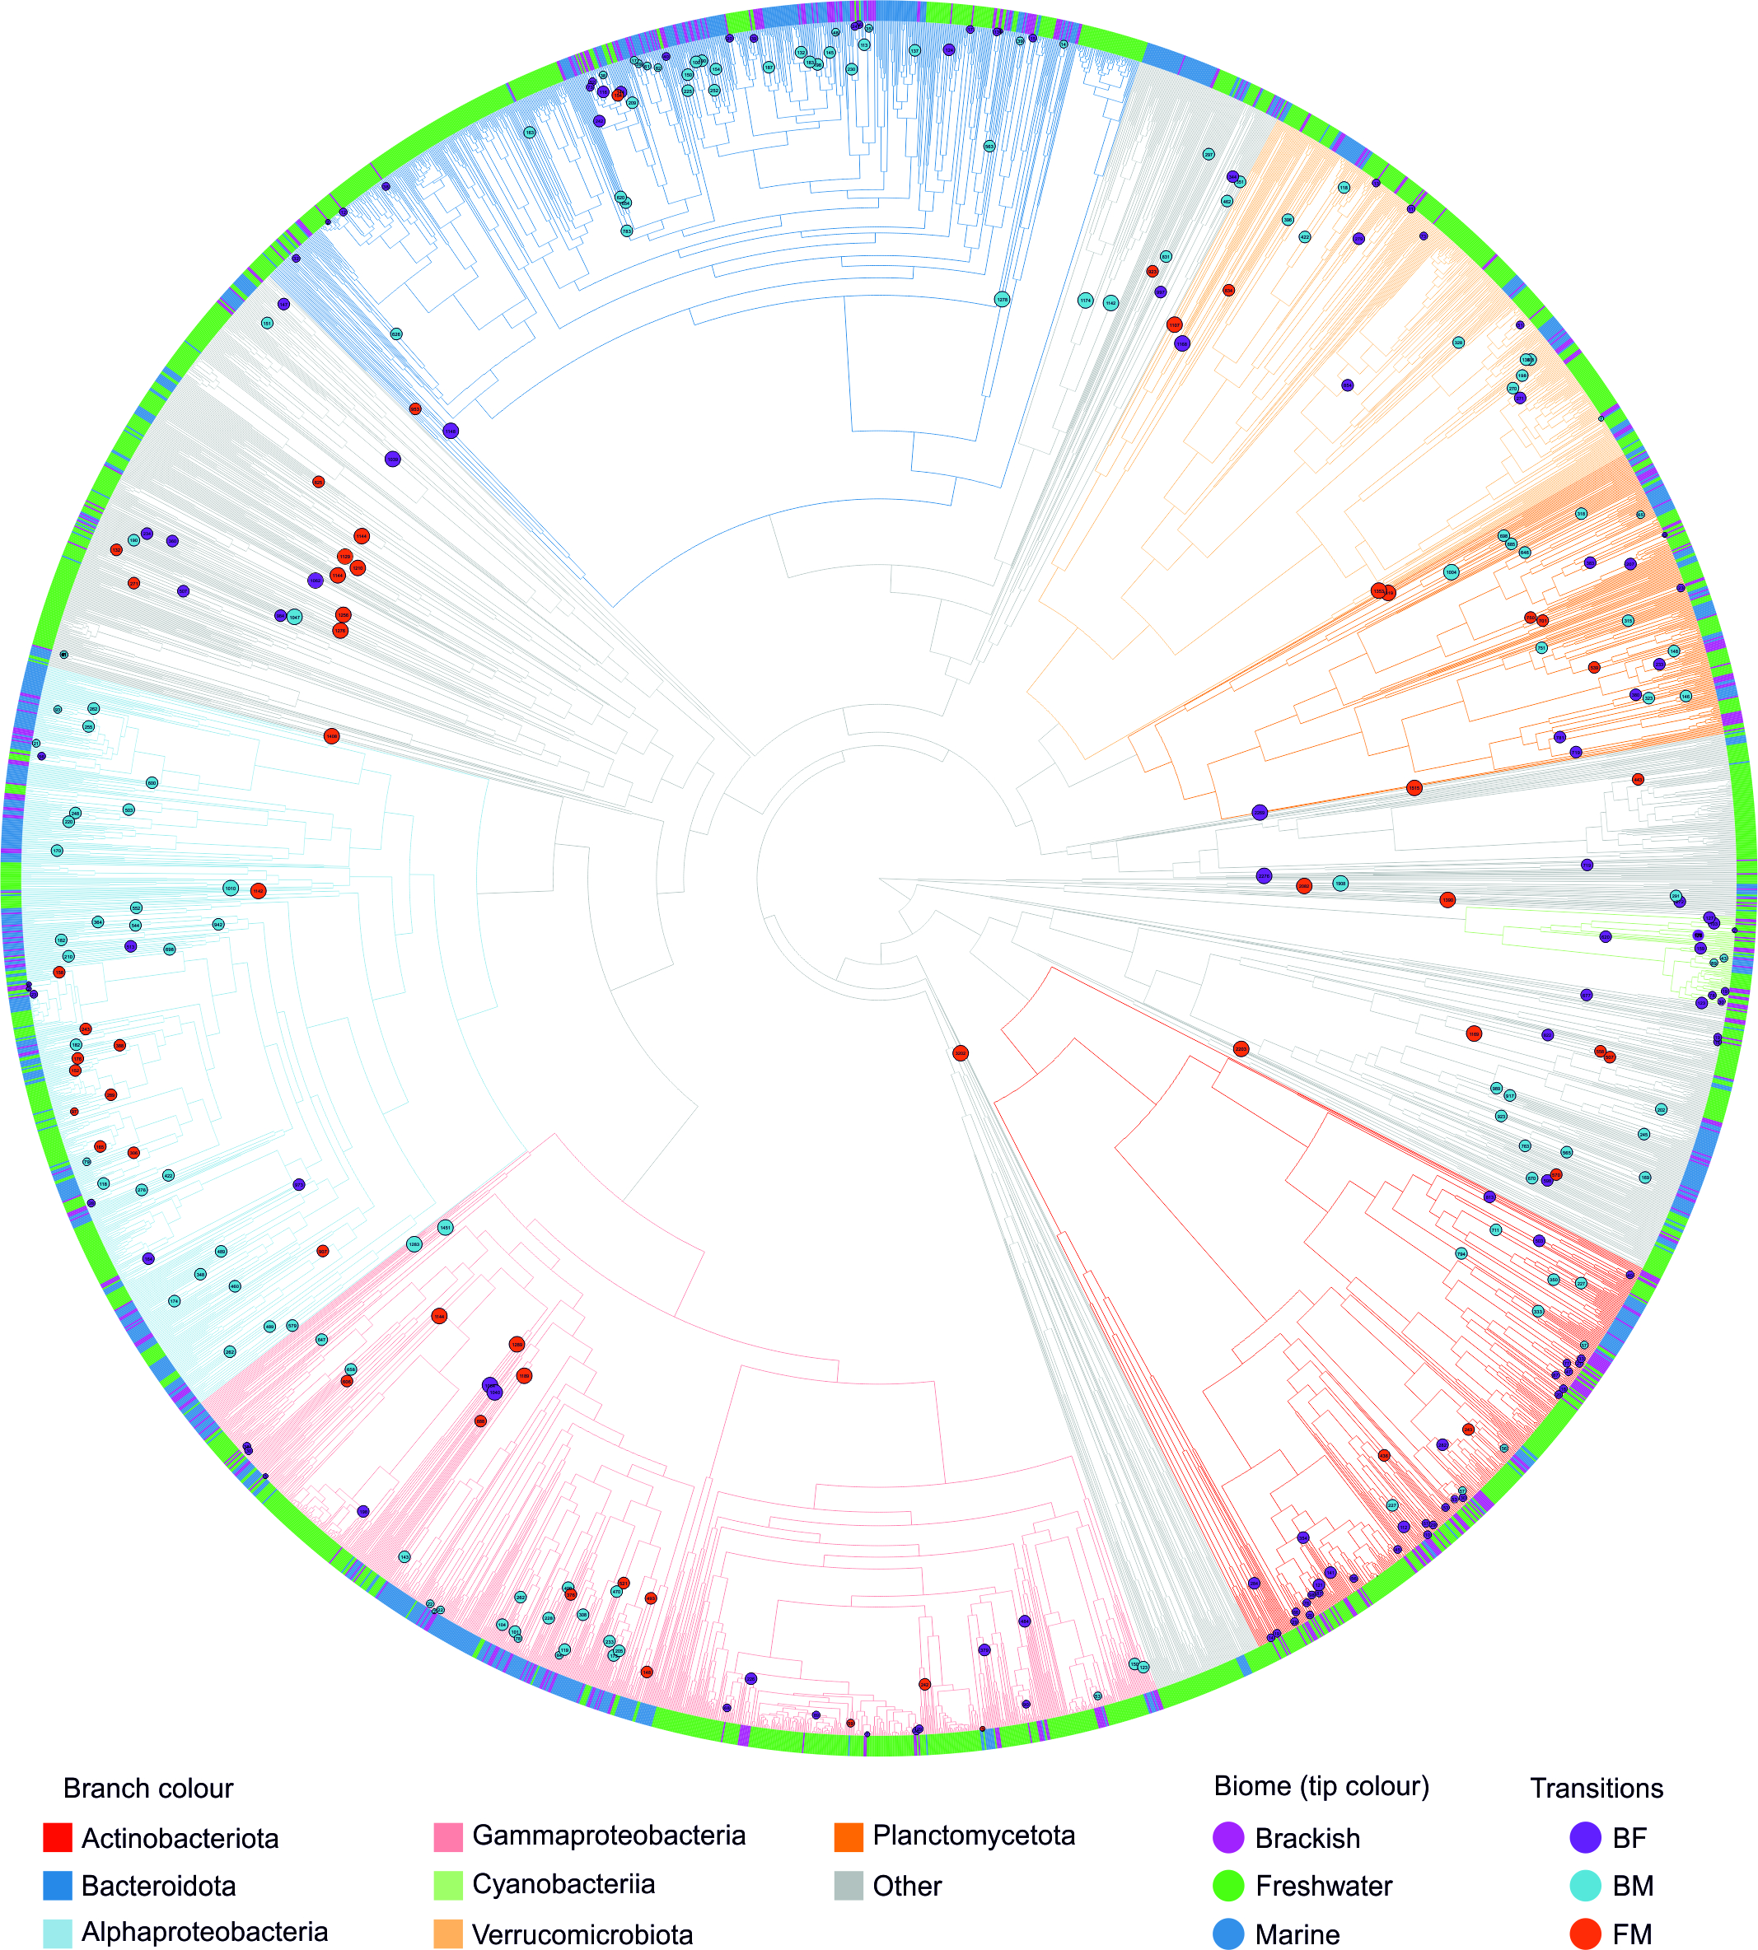
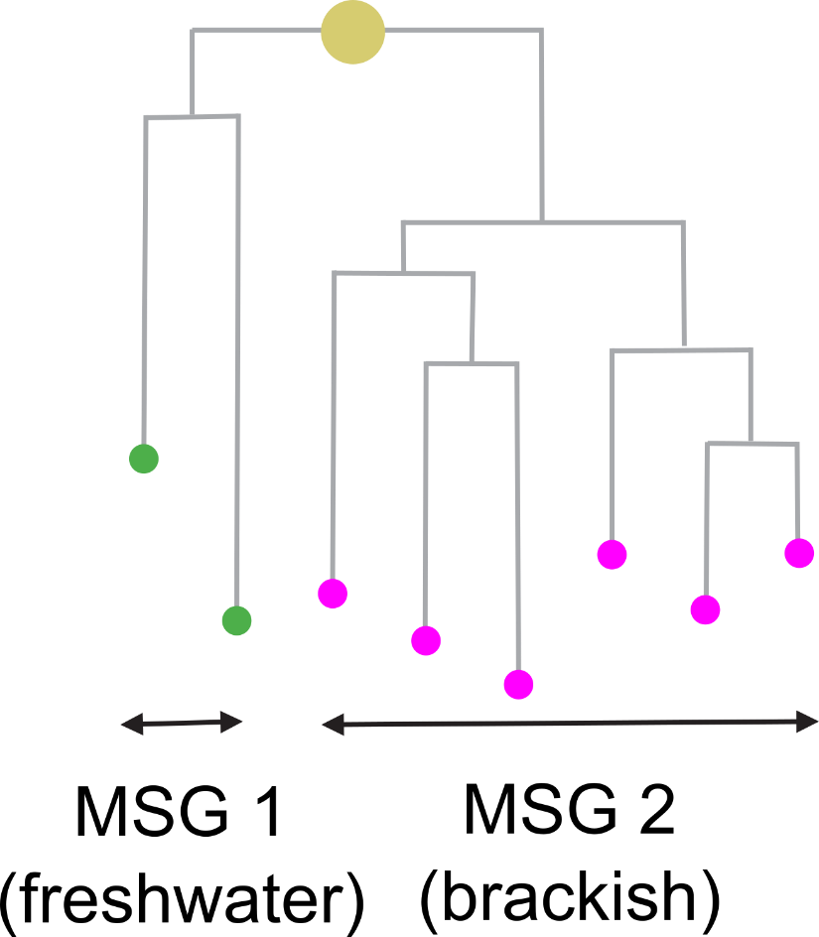
We identified most-recent cross-biome transitions across the bacterial tree of life
MSG – Monobiomic Sister Group

Slide 8

Cross-biome transitions were rare
Observed
Expected

Slide 9


Transitions happened more often into than out of brackish waters

Slide 10

We identified no recent cross-biome transitions
Age of: Baltic Sea Caspian Sea
8 kya
2-3 mya
Niches filled by migration not adaptation

Slide 11
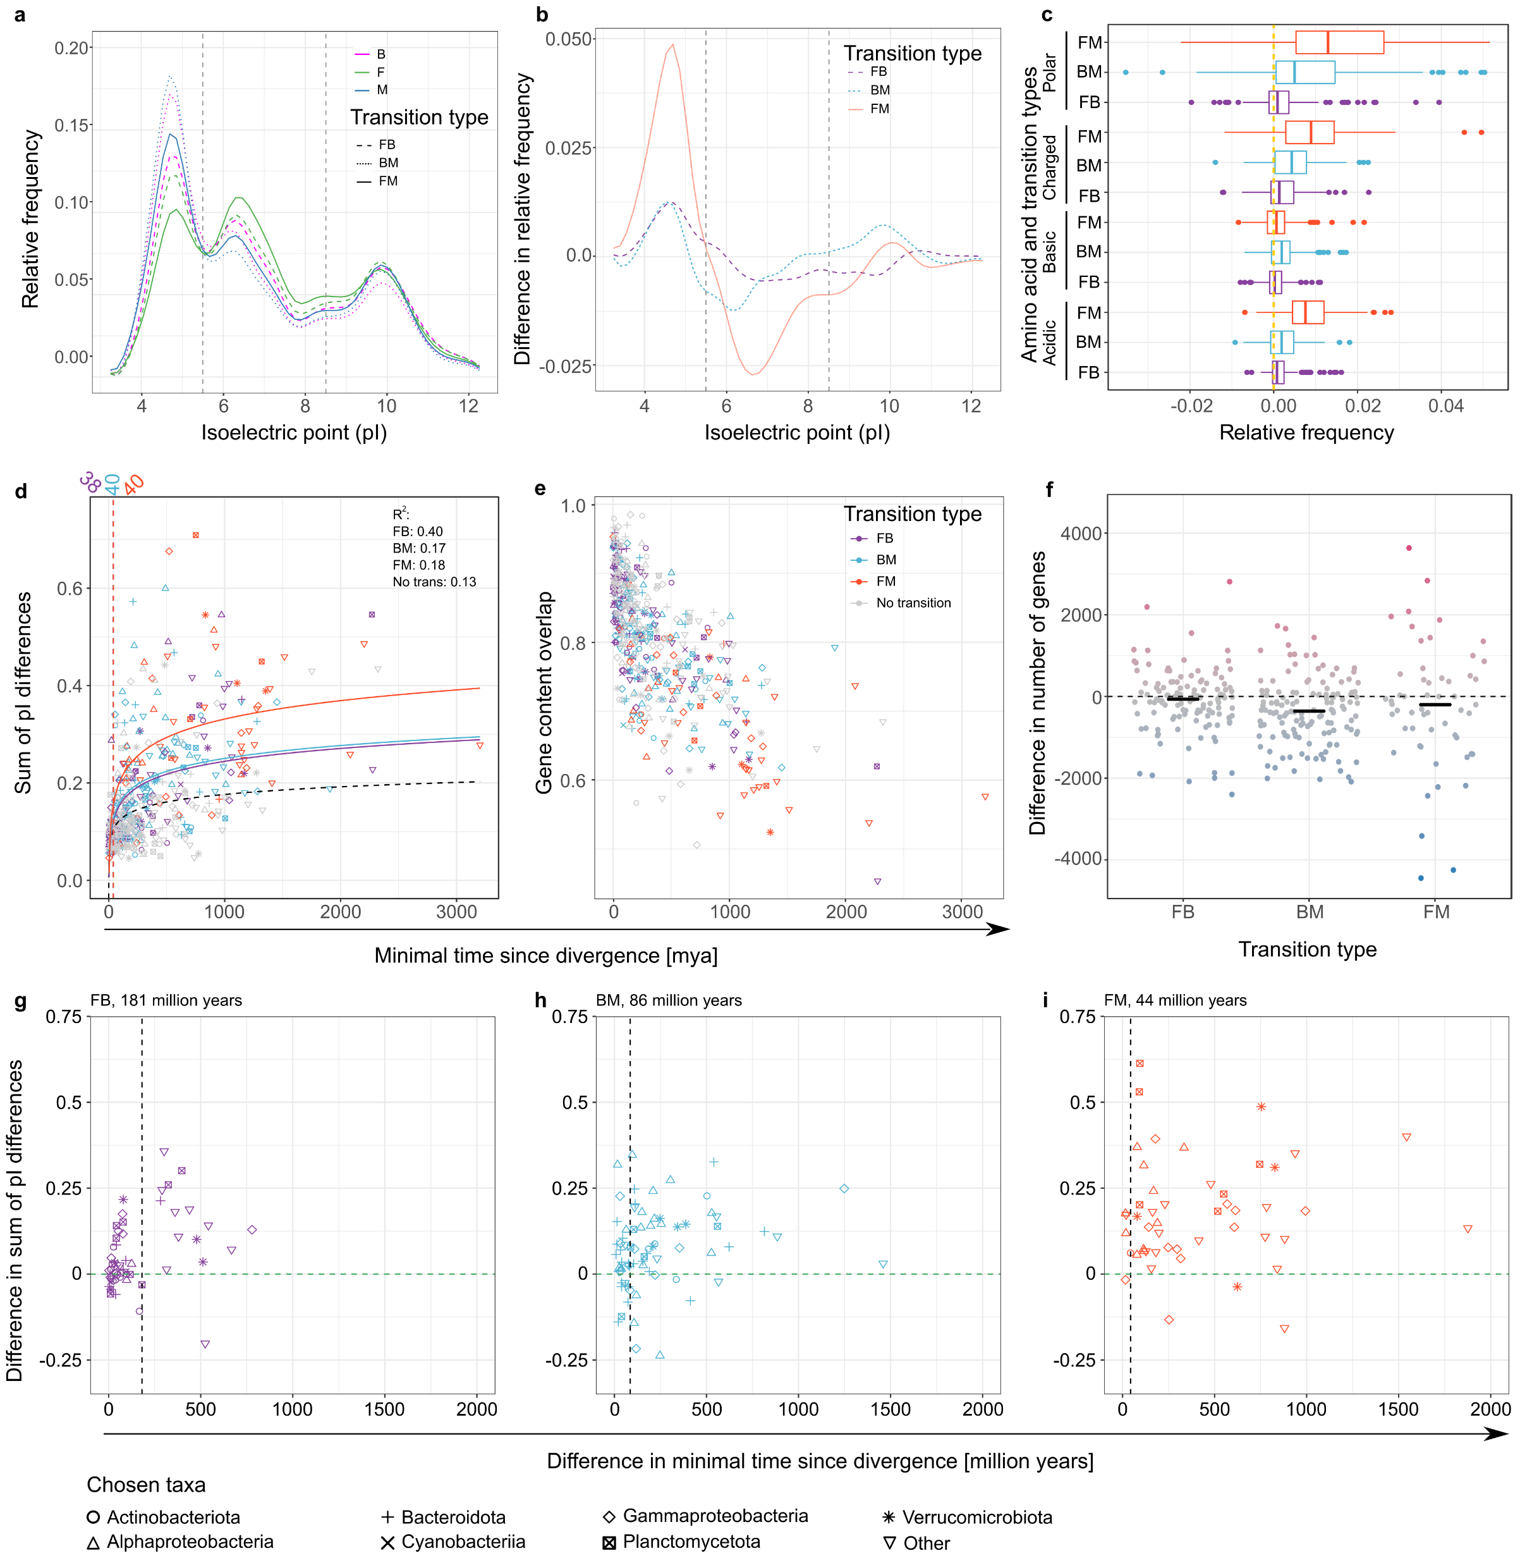
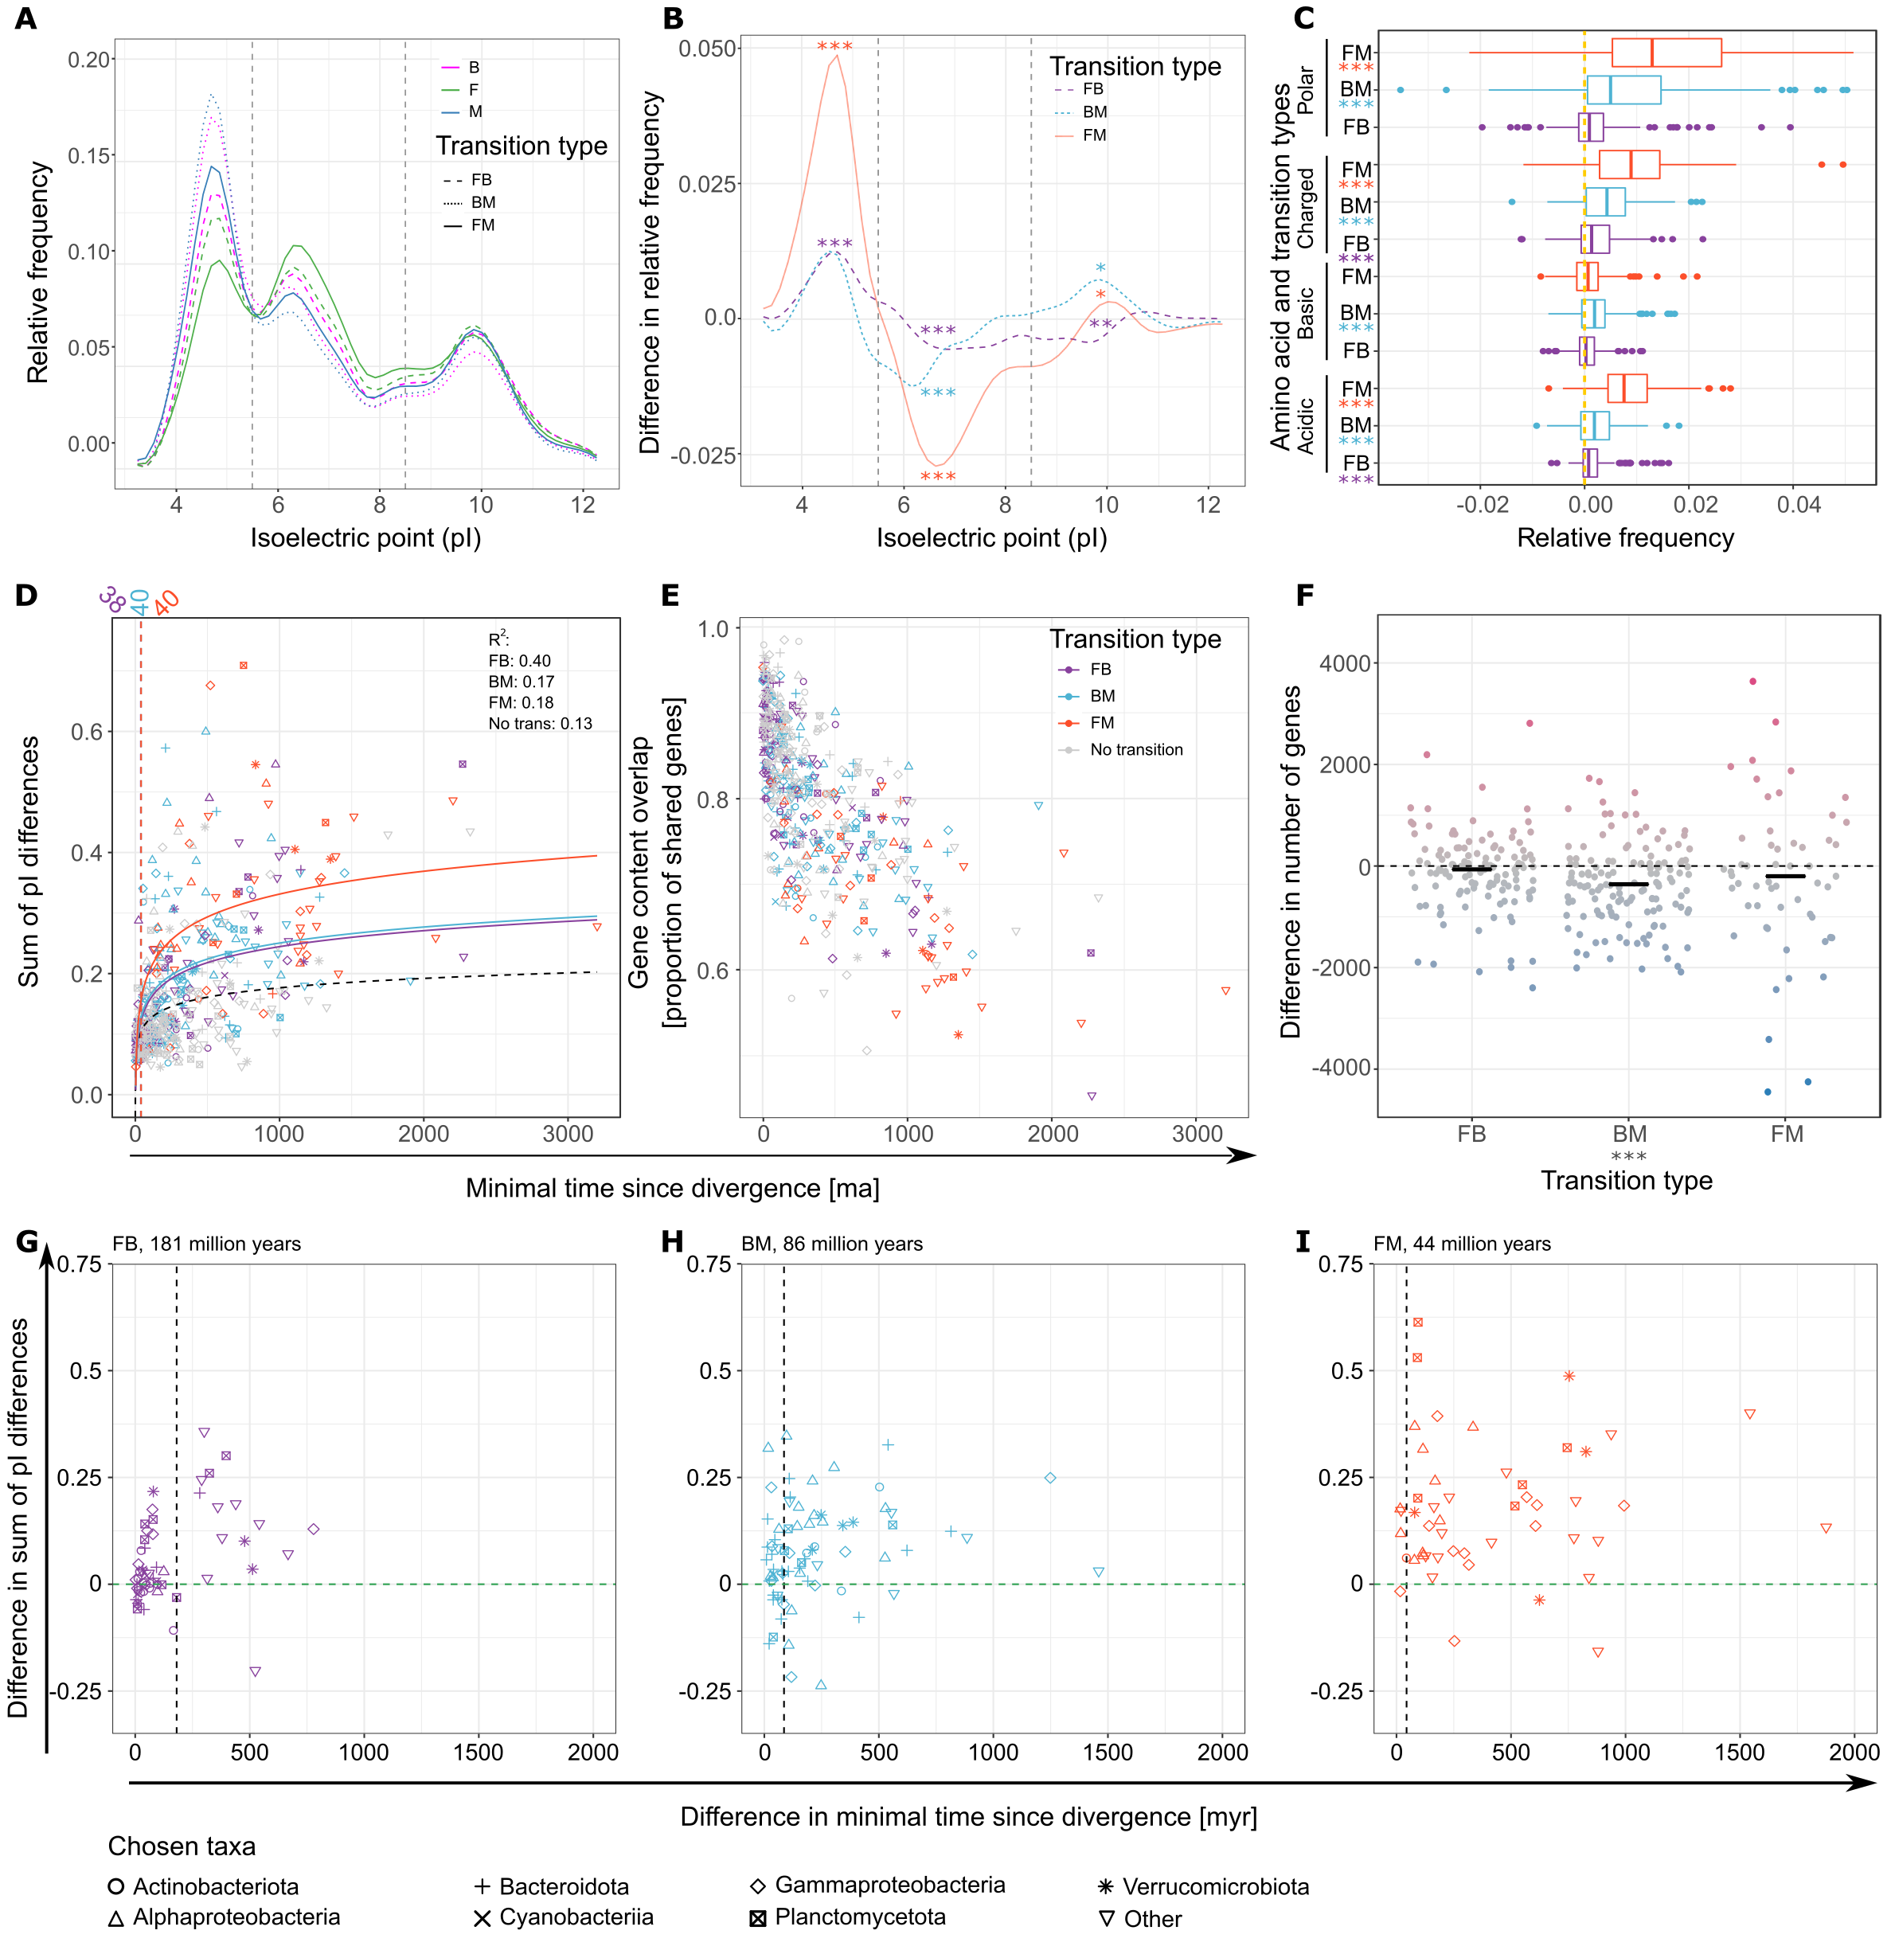
Wide-scale changes in proteome properties are driven by differences in the frequency of acidic amino acids
Inspired by Cabello-Yeves and Rodriguez-Valera (2019)

Slide 12
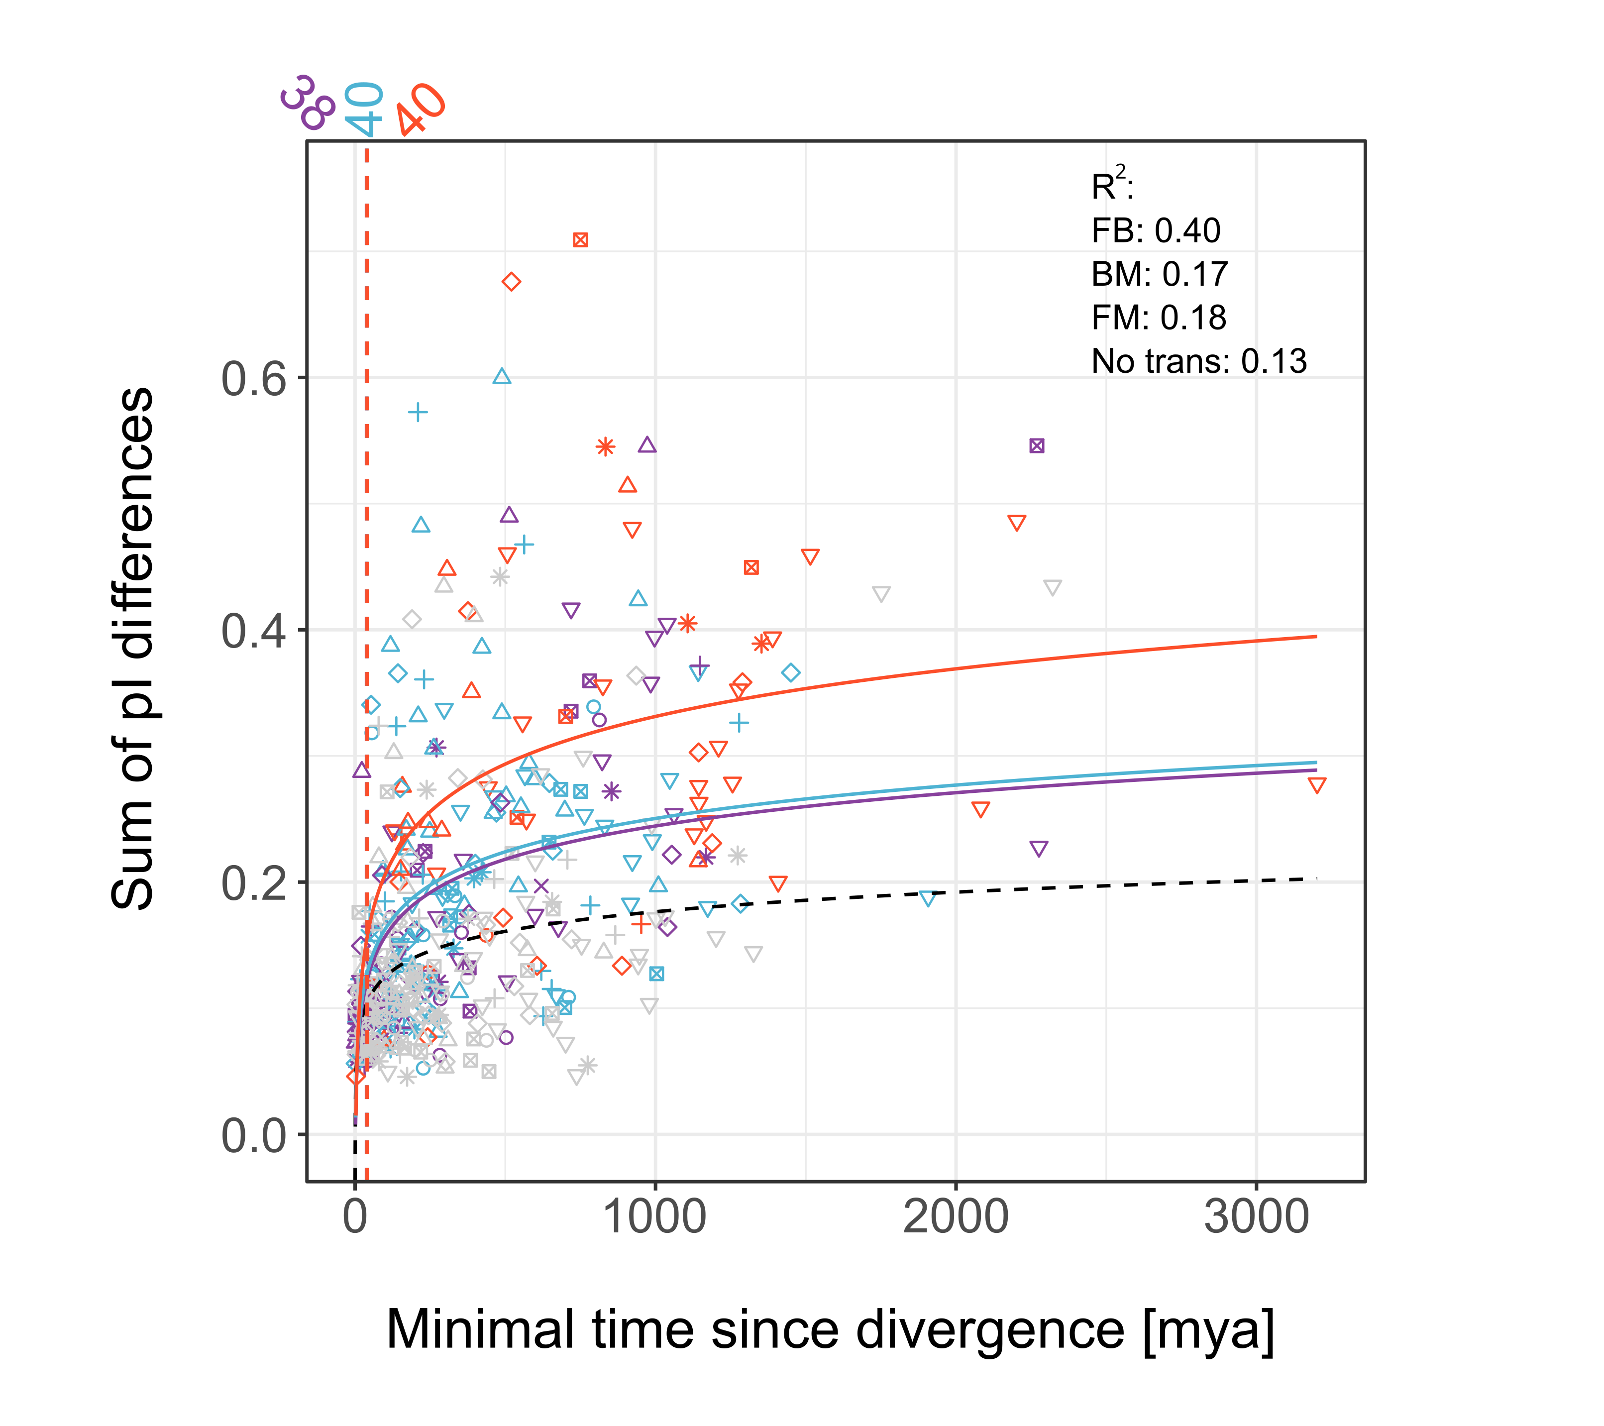
The shift in pI takes considerable amounts of time
After corrections:
44 million years for FM
86 for BM
181 for FB
Hard to overcome barier – sets biome separation?

Slide 13
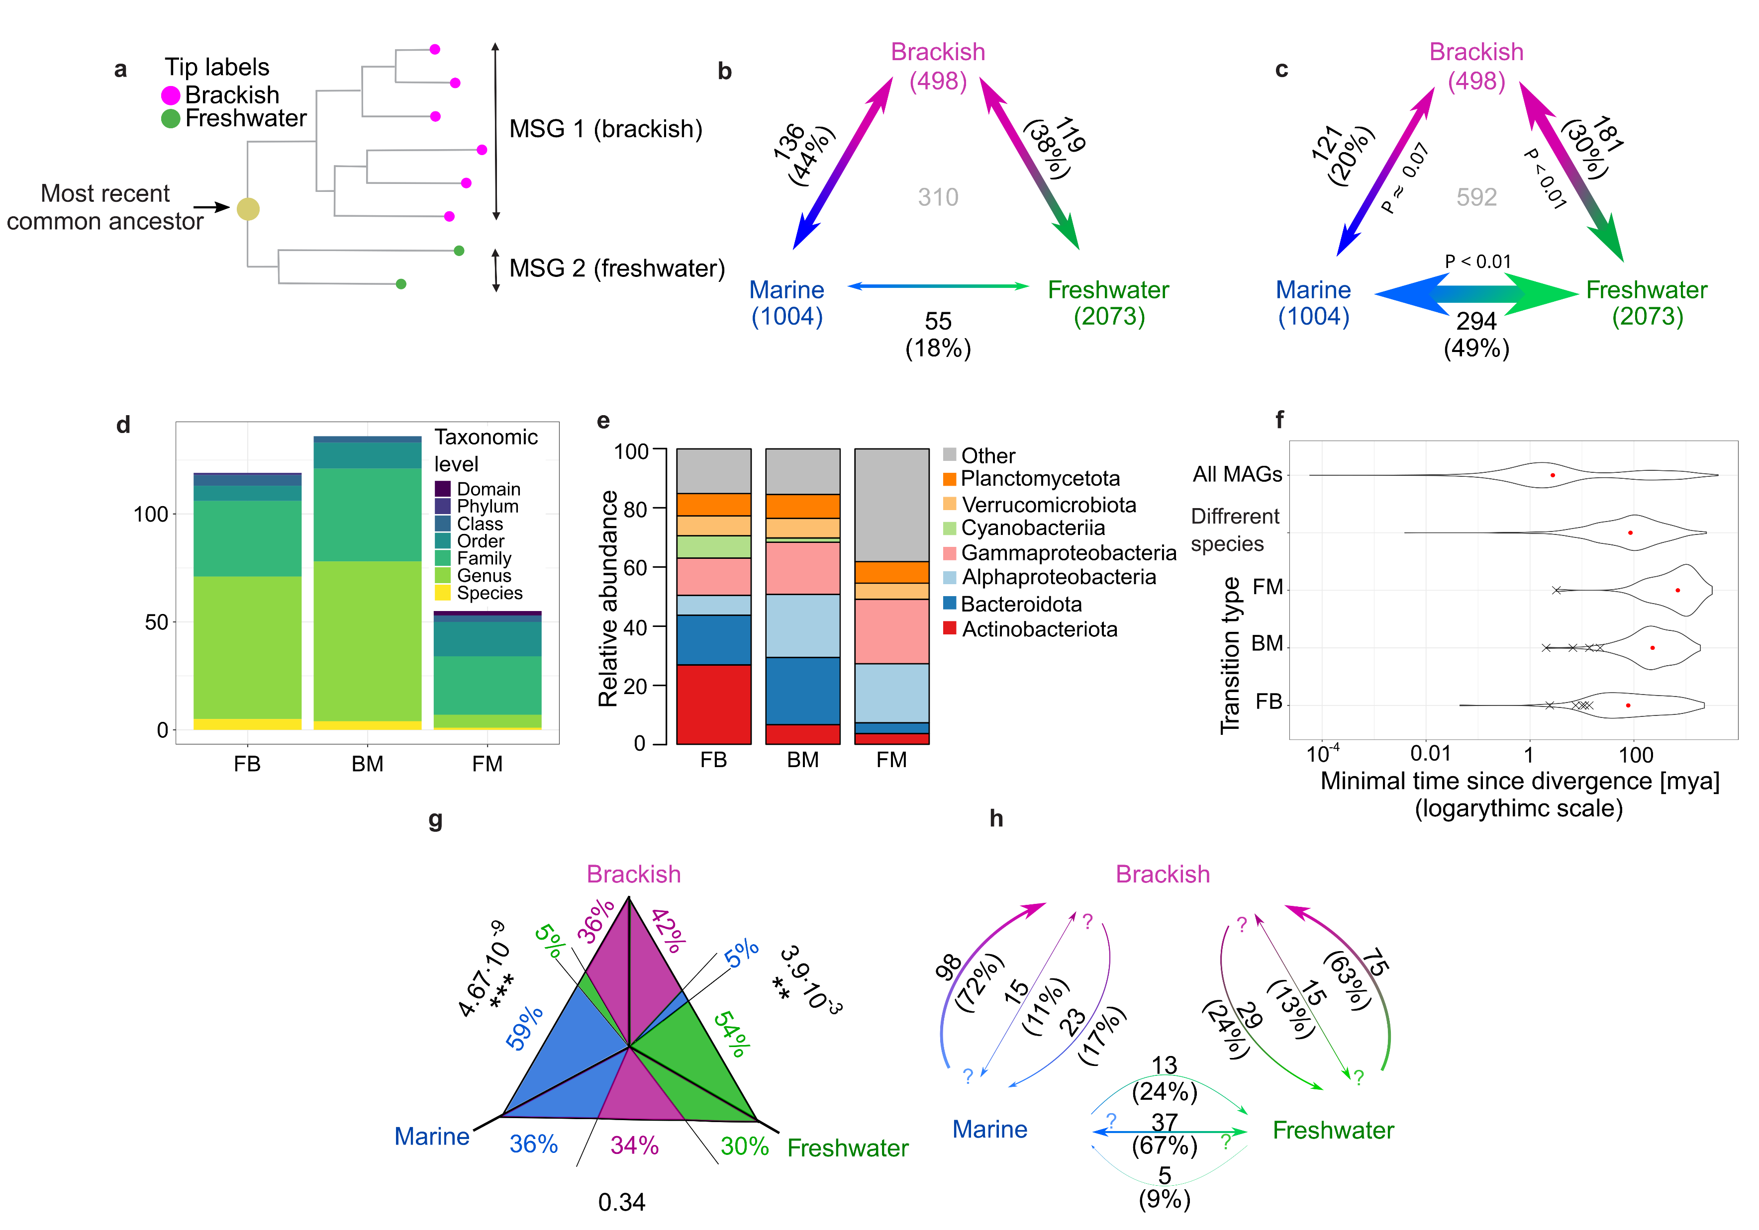
Brackish genomes contain more genes than their marine counterparts
Observed
Different MGE exposure
Biome separation set recombination barier leads to speciation?
Expected

Slide 14
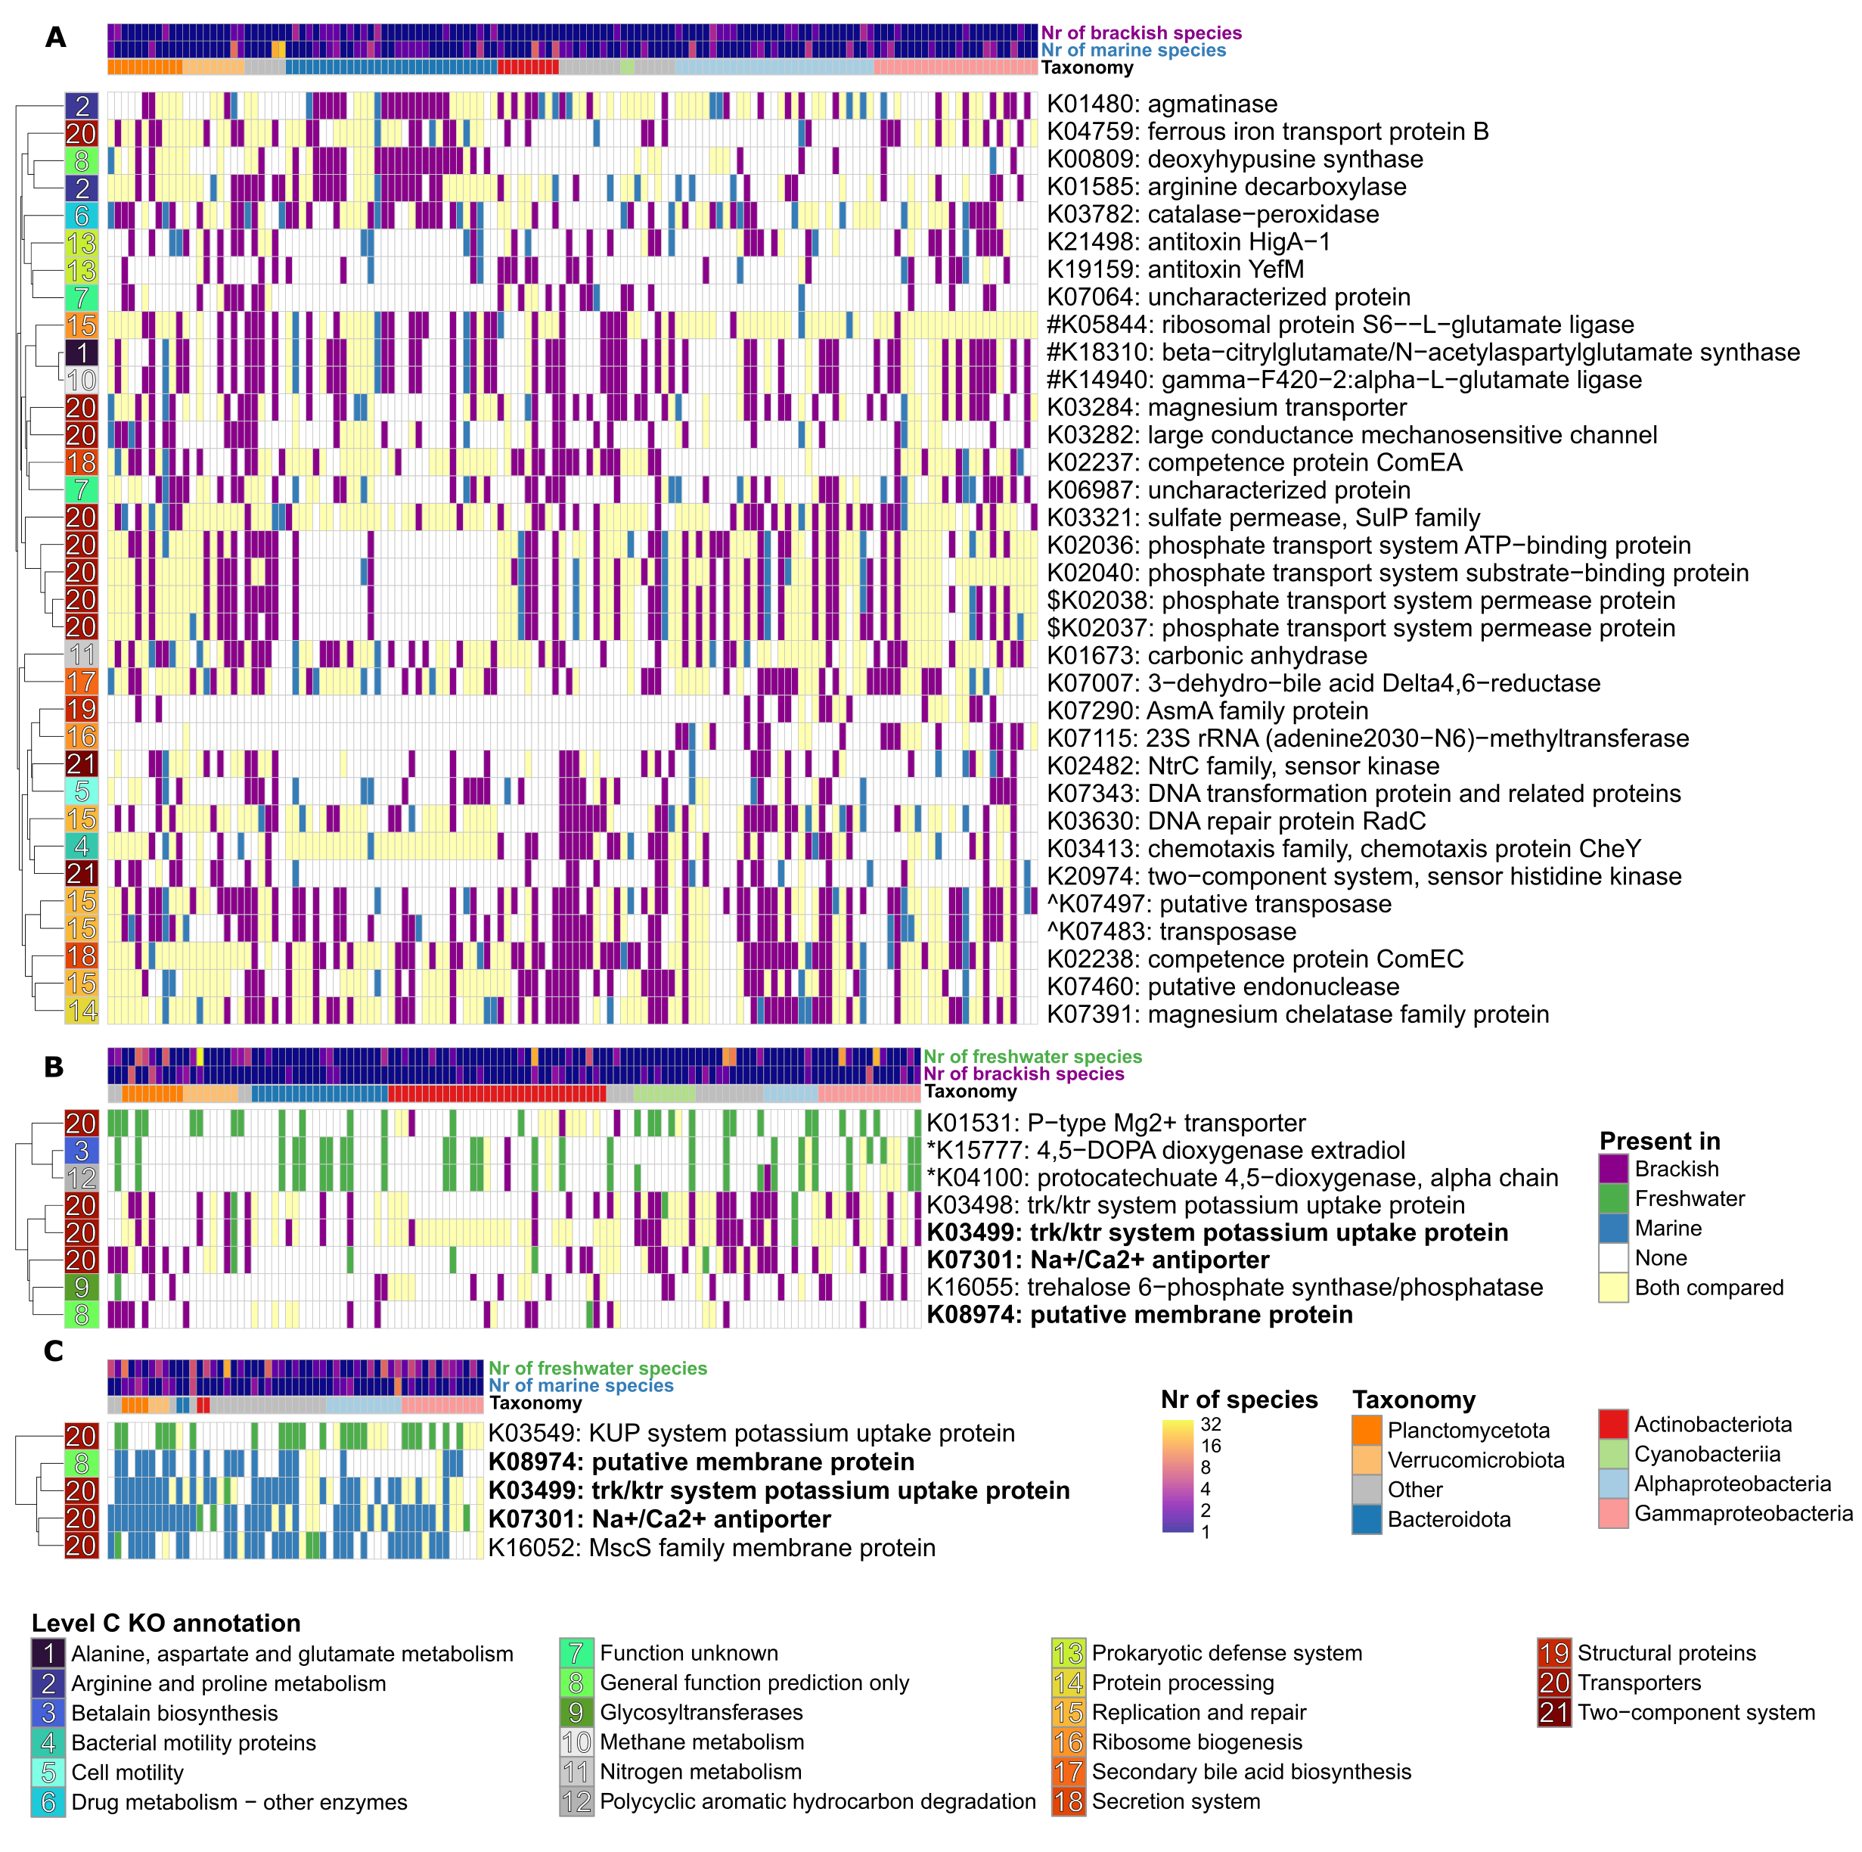
Gains and/or losses of the same functional genes allow diverse bacteria to transition between biomes
Freshwater ↔ Brackish
Marine ↔ Brackish
Freshwater ↔ Marine
Some “obvious”, e.g. K+ uptake systems,
Na+-coupled transport
Not discussed before but directly connected e.g. Mg2+ uptake,
chemotaxis
More complex and/or cryptic e.g. modifications of charged amino acids
transposases, antitoxins, and competence proteins

Slide 15

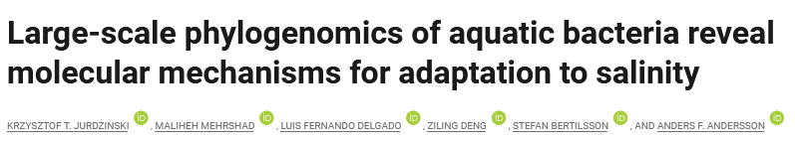
Conclusions
Different bacterial species inhabit different biomes.
Cross-biome transitions are rare, ancient (mya) and more often into than out of the brackish biome.
Cross-biome transitions lead to systematic changes in proteome composition…
…and gain or loss of specific gene functions.

